Slide 1
Loghunter-DesktopTool Introduce
  What is it ?
  This is a desktop applet that simplifies the whole process of rflog analysis in loghunter.
  How to achieve it?
  Here I use Tkinter, a library built in python that can realize GUI interface programming. The layout of the whole page is mainly organized by the tabel control, iframe control and button control. Then, the function methods that implement the business logic are bound through the 'command' parameter inside the control.

Slide 2
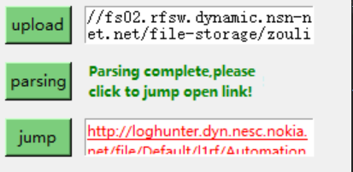
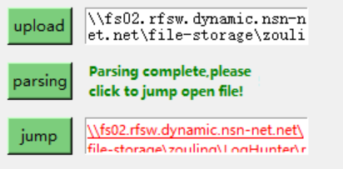
Loghunter-DesktopTool Introduce
  Step 1: click 'upload' to upload the file or directly enter the directory of the file in the input box.
  Step 2: click 'parsing' to parse.
  Step 3: click 'jump' to jump.
  How to use it?
Notes:
Introduce the basic driver of the innovation

Slide 3
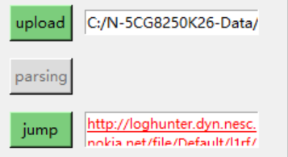
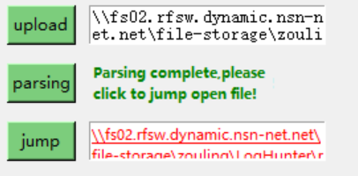
Loghunter-DesktopTool Introduce
  Iteration version:
      -- Left side:version1.0
      -- Right side:version 1.1
Notes:
detail description of the innovation with words and figures including the following point

